Slide 1
Escape Room who is the murderer?
BY Hannah & Kylee

Slide 2
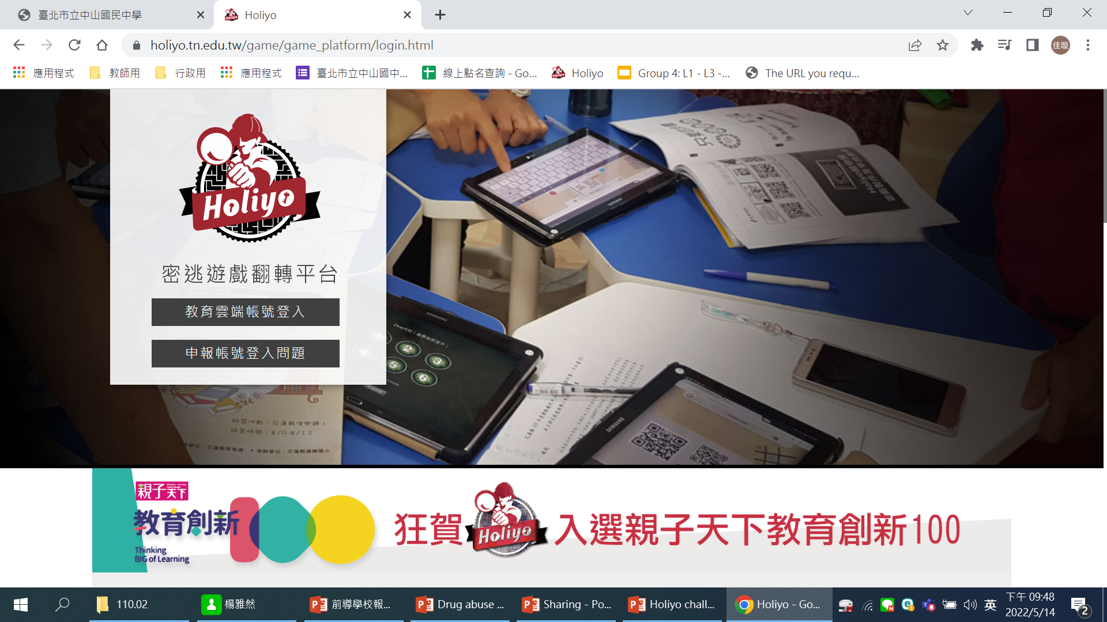
THE IDEA COMES FROM…..
Drug abuse NEWS
Escape room

Slide 3
CAN YOU FIND THE MUDERER?

Slide 4
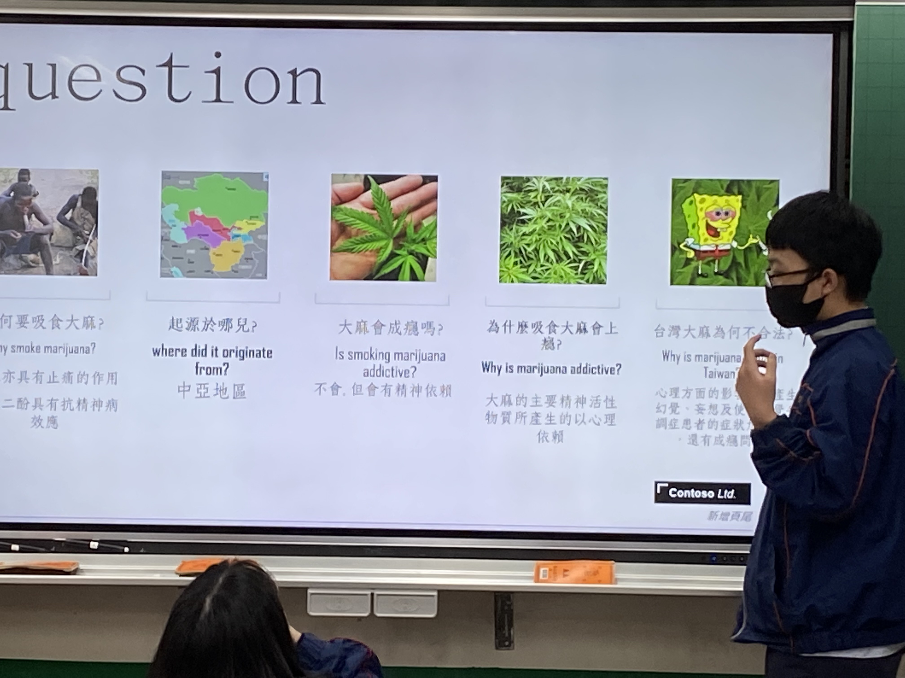
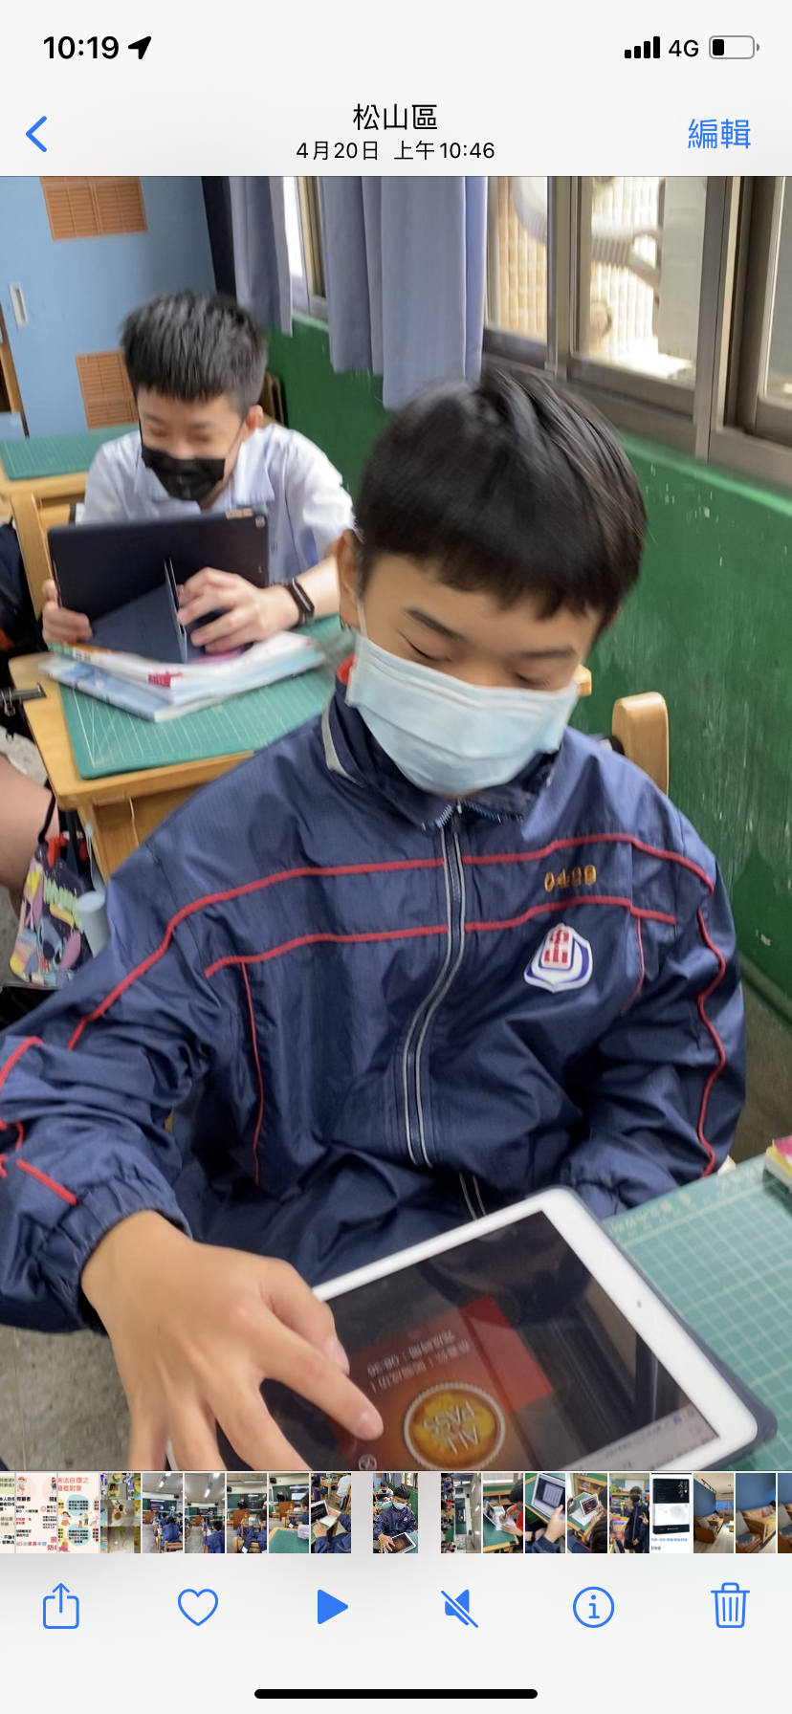
OUTLINE
1
2
3
How to make a good presentation
Group presentation
Escape room
challenge

Slide 5
01
How to make a good presentation
?
?

Slide 6
Process Timeline
6 W
6 Drugs
A task
Catch your eyes
At least 10 pages
Team work

Slide 7
Group presentation

Slide 8
Escape room challenge
Challenge 1
Challenge 2
Holiyo (tn.edu.tw)
Holiyo (tn.edu.tw)

Slide 12
Please unlock her cellphone

Slide 13
CHALLAGE 1

Slide 14
Passcode 3

Slide 15
Escape room challenge
Challenge 1
Challenge 2
Holiyo (tn.edu.tw)
Holiyo (tn.edu.tw)

Slide 16
Table of Contents
HOSPITAL
01
02
Overview
Assignments
Here you could describe the topic of the section
Here you could describe the topic of the section
03
04
Features
About the Topic
Here you could describe the topic of the section
Here you could describe the topic of the section

Slide 18
CHALLAGE 2

Slide 24
DRUG 2

Slide 25
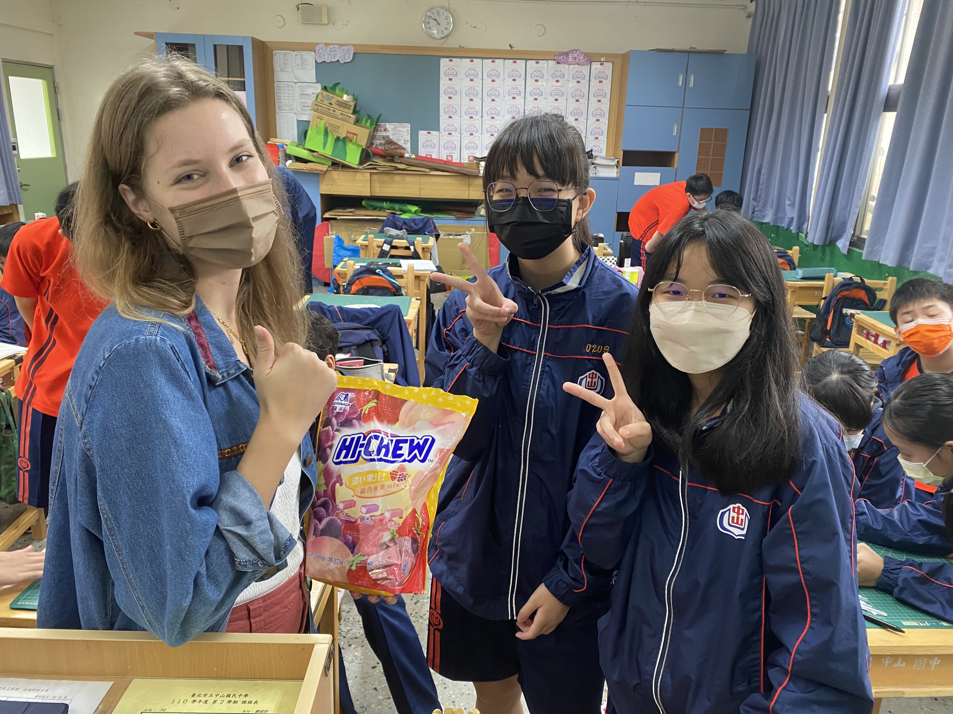

Slide 26
Outcome
教師利用6w問題去引導學生思考，學生自主學習-毒品知識，學生為學習中的主動者，教師為輔助角色。
遊戲式教學法，學生能融入其中且樂於挑戰。
互相幫忙，正向的競爭。
遊戲也是評量。
事前備課，教師輕鬆，學生開心。

